Slide 1
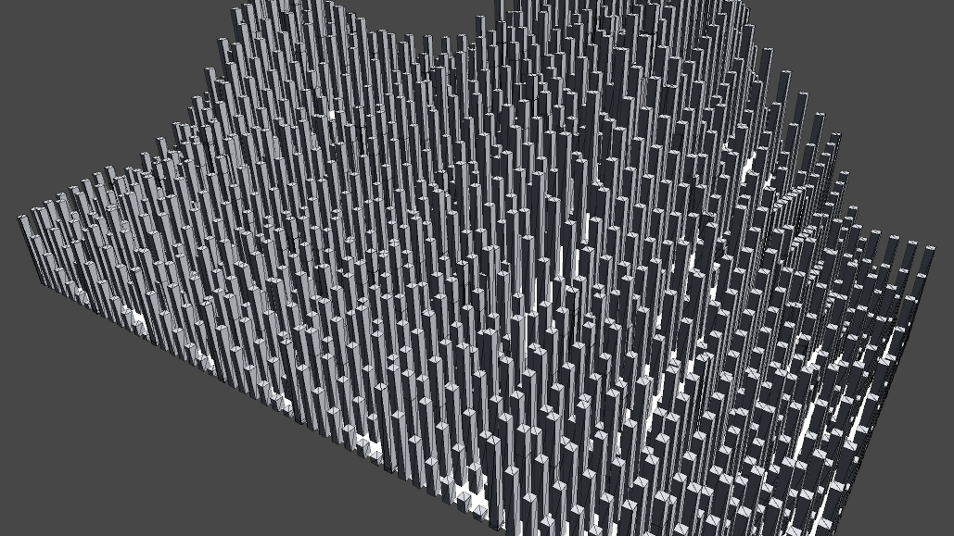
Parametric object creation
Create everything with a click.
By Øyvind Sørøy 2020

Slide 2
Why?
Parallel creation to increase efficiency
more iterations quicker for design ideas
Easier approach to mass production

Slide 3
What?
Simplifies 3D-creation
Reduces file size and complexity
Extreme flexibility over prefabs

Slide 4
How?
Establish domain for generation usage
Tune creation parameters
Iterate variations until satisfied

Slide 5
Who?
Entertainment
Movies/series/games
Construction
Homes/offices/public
Robotics
manufacturing/repair

Slide 6
Current WIP prototype
In development since late 2019 on the side.
Focus on structures and inanimate objects to test capability of creation algorithm.

Slide 7
Prototype status
Creation of buildings based on parametric input provided by user and/or map data.
Real-time at run-time for speed, performance, and compatibility across devices.
To establish what is possible with current hardware.
Parametric, real-time, possible.

Slide 8
Prototype status part 2
Implemented in Unity 3D for the time being.
To be used with ML/AI as a generative step above, replacing human input.
A demo is available showing city/car generation and single object manipulation.
Flexible, automated, available.

Slide 9
Game prototype
Shows the application in use in a game. This will be part of a demonstration of the MVP to showcase its potential to people.

Slide 10
Building prototype
Shows the application in use in a construction survey setting. Made for AR with handsfree devices in mind like a HoloLens or similar. Can be part of the MVP as a showcase.

Slide 11
Remaining for Prototype
Custom triangulator integration
Visual implementation of elements
Upgraded JSON parsing

Slide 12
User interest response
Rather overwhelming, as more than anticipated are interested in using the technology.
Offers from a few gaming-related companies to use the full product in their pipelines.
Based on posting the prototype around various channels on the internets.

Slide 13
MVP-status
Only for Unity 3D-related use.
Singlethreaded as per writing this (will become multithreaded).
Runs at 60fps on a medium-spec laptop.
To be used on devices like AR/VR/mobiles for simple demonstrations.
Completion date: Late 2021

Slide 14
Remaining for MVP
Custom UI and ux
Webpage with download
Simple user documentation

Slide 15
Full Product Version
Own suite as well as custom API-call implementations through .DLLs/similar.
Export options of generated 3D-objects and/or parametric data templates.
Pay per upgrade or rolling subscription with possible tiers. Will accept crypto.
Standalone, technical, consumable.

Slide 16
Capital investment needs
1 million NOK for completion of a first public release (MVP).
Pending initial feedbacc and potential success, another 2-3 million NOK to bring it into LTS.
«Guerilla» marketing strategy by going through social media channels showing what is possible.

Slide 17
Investment budgeting
20% Research
50% Development
15% Testing
10% Management
5% Tools
Approximate numbers.

Slide 18
Company leadership
Øyvind Sørøy
Founder
Lead Developer/project vision
(From Colonthree Enterprises AS)
Dag jørgen finskud
ECONOMICS/BOARDMEMBER
(FROM COLONTHREE ENTERPRISES AS)

Slide 19
Additional project help
Dragos Dogaru
Developer
(From goldman sachs)
Christian Antkow
AR/VR technician
(From oculus)

Slide 20
Questions?
We shall be happy to answer. :3

Slide 21
Thank you for your time!
«Parametric Object Creation» as presented by Øyvind Sørøy, 2020

